Slide 1
Employee Empowerment Strategies
(Prosocial Behaviors are Contagious)
Notes:
Alex suggestions for 2 people doing training:
Person 1: Slide 1-12
Person 2: Slide 13-24
Person 1: Slide 25-39
Person 2: Slide 40-51

Slide 2
Disclaimer
Tools offered in this training do not address or change reporting obligations regarding illegal harassment or misconduct.
This training does not offer legal definitions or interpretations of harassment according to any institution’s policy.
This training is intended to encourage open discussion of these issues.

Slide 3
Safety Statement
This is a Brave space to have an open, honest discussion free from judgement and bias.
Anyone unable to step IN with this intention, or anyone who is uncomfortable with open discussion of harassment topics is free to leave. We will not judge.

Slide 4
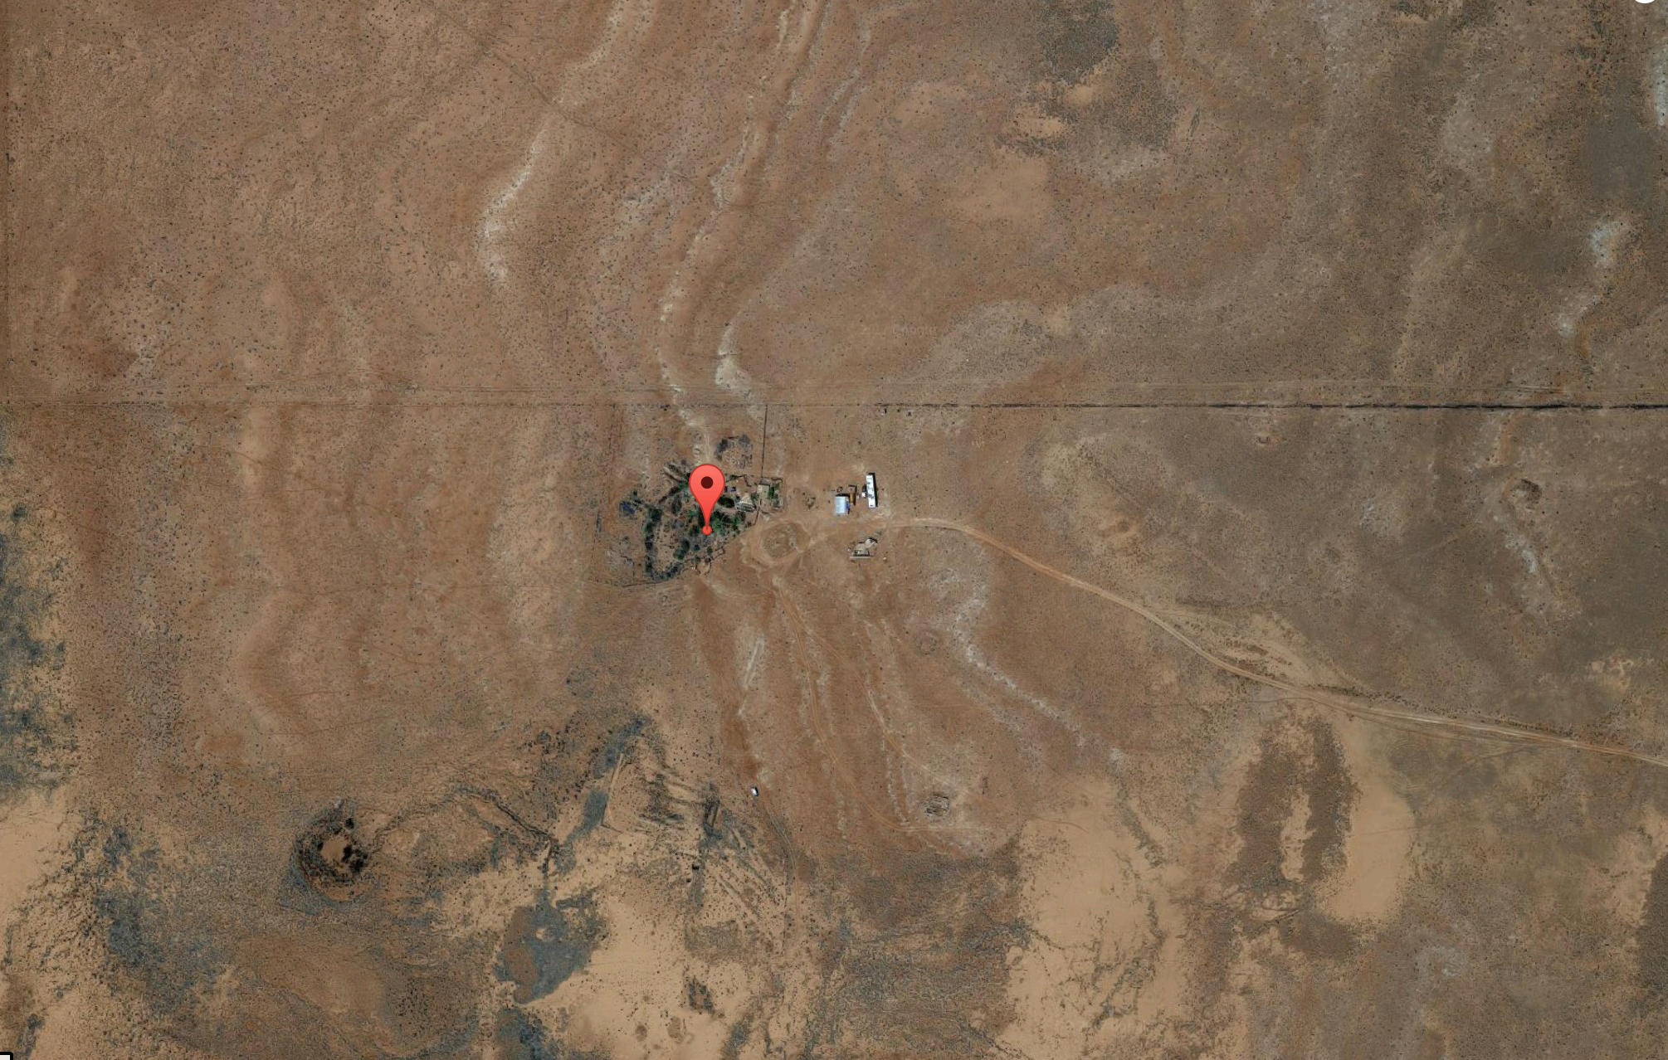
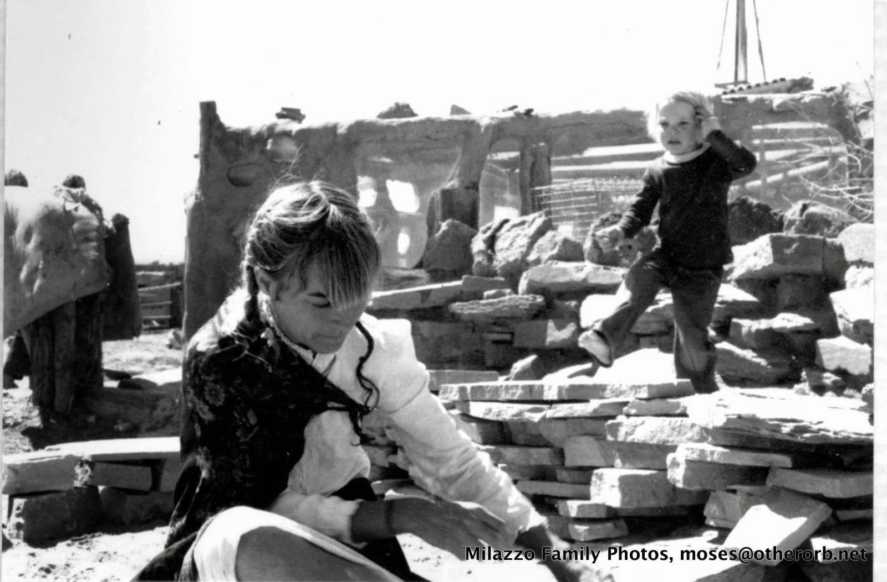
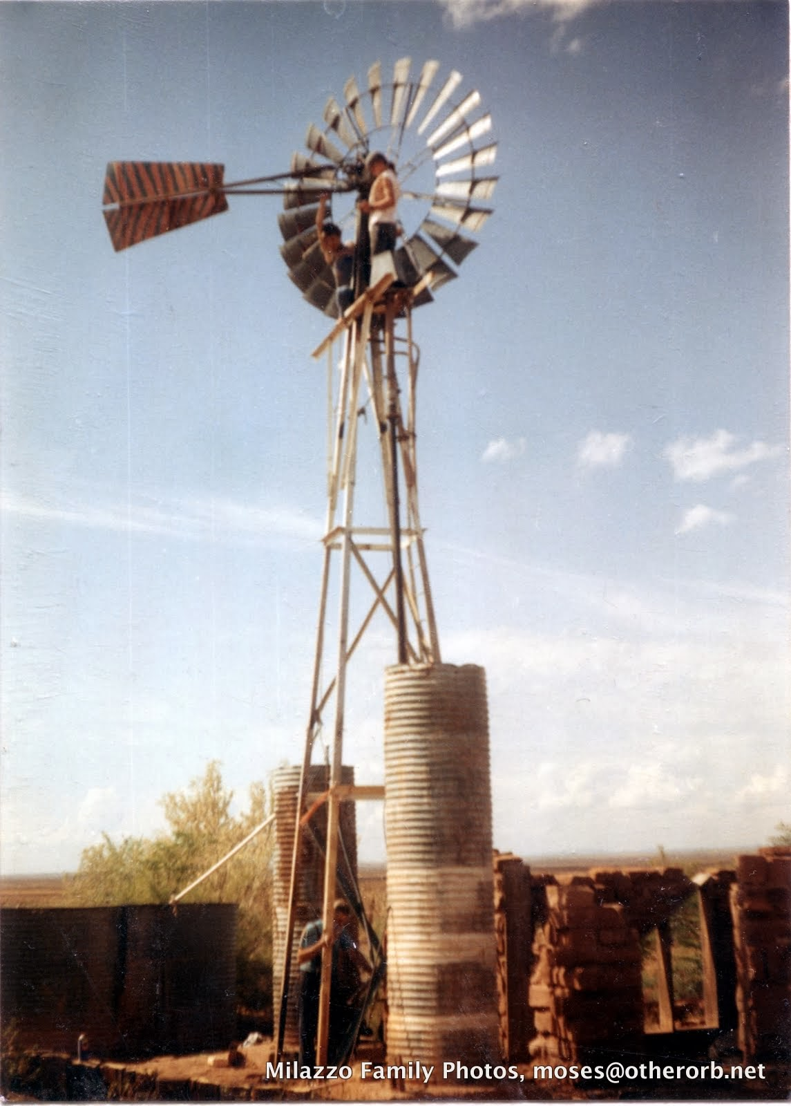
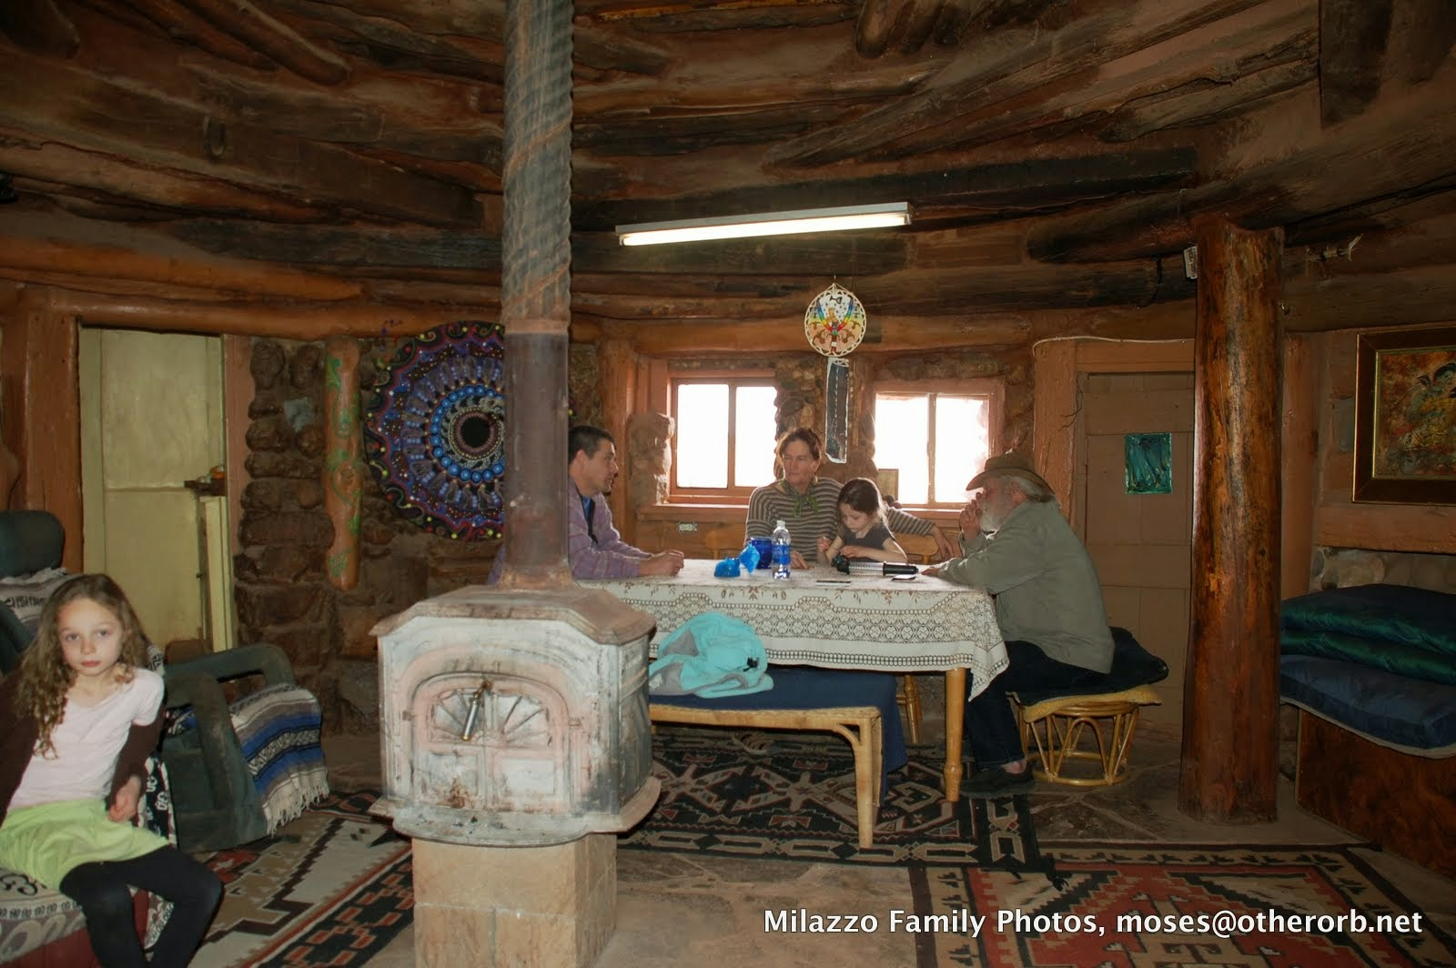
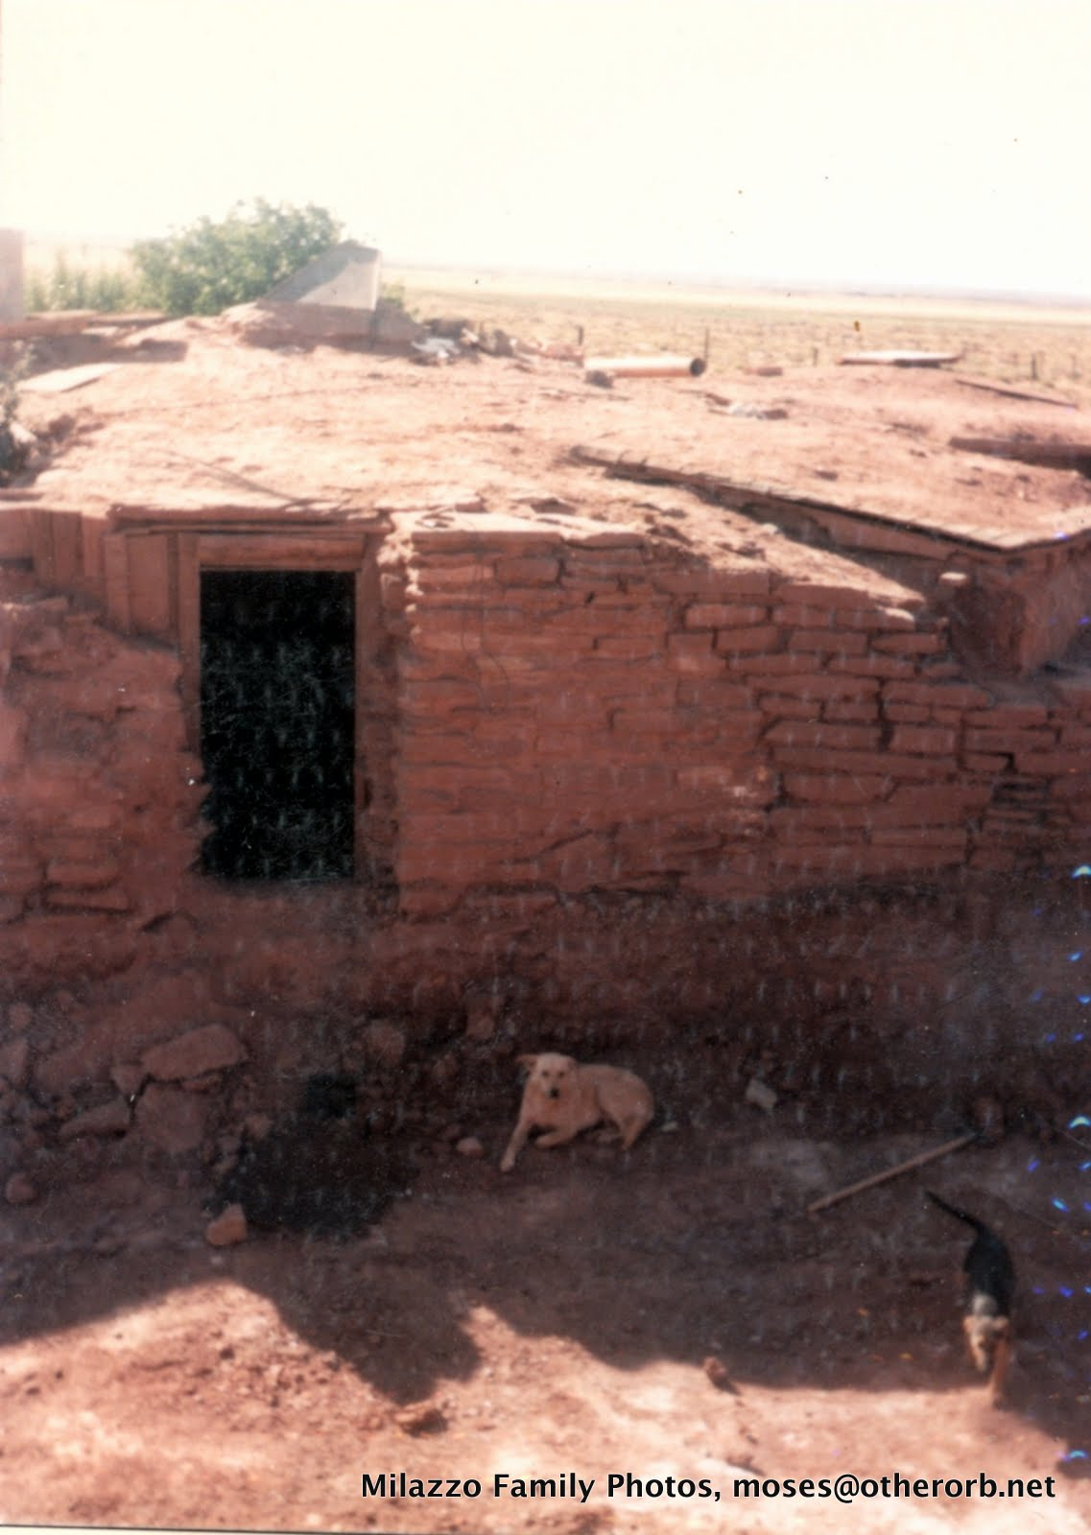
About Me

Slide 5

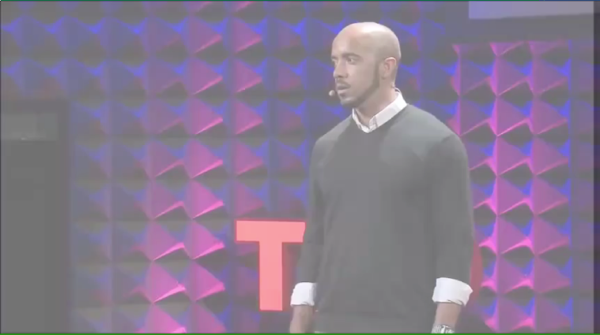
CLINT SMITH VIDEO
Clint Smith
Silence

Slide 6
Agenda
Goals
Bystander Effect
Step UP! Training
Q&A

Slide 7

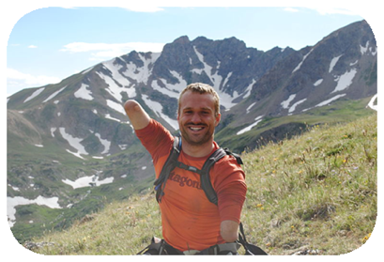

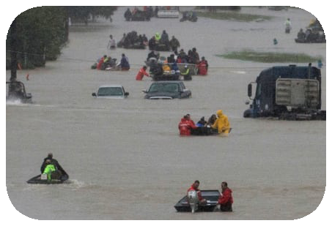
Goals
EDUCATE
MOTIVATE
EMPOWER
ACT
Notes:
Motivate: Kyle Maynard was born with a quadruple congenital amputation. He became a wrestler and football player in high school. He was the first quadruple amputee to climb Mount Kilimanjaro without the aid of prosthetics. He is a motivational speaker, CrossFit Certified Instructor and gym owner, competitive MMA/Brazilian Jiu-Jitsu fighter, world record-setting weightlifter, and skilled mountaineer.
Alex Notes:
We all see issues where we could be an ally and take action to stop mistreatment or help a person in need. This training will give us tools to put this idea into practice.

Slide 8
Theories
Bystander Effect
Social Norms
Power Dynamics
Privilege
Microaggressions
Prosocial Behaviors
Motivational Interviewing
Notes:
Prosocial behavior – presentations can create internal confrontations – (cognitive dissonance). Bystanders well trained more likely to help effectively.
Motivational interviewing – change happens when explore and try to resolve ambivalence
Cognitive dissonance – values / behaviors not aligned
Social norms – correct misperceptions, increase healthy behaviors

Slide 9
Theories
Bystander Effect
People are less likely to intervene when they are in a crowd than when they are the only bystanders.
Notes:
Prosocial behavior – presentations can create internal confrontations – (cognitive dissonance). Bystanders well trained more likely to help effectively.
Motivational interviewing – change happens when explore and try to resolve ambivalence
Cognitive dissonance – values / behaviors not aligned
Social norms – correct misperceptions, increase healthy behaviors

Slide 10
Theories
Social Norms
Behaviors expected by the community of which one is a member.
Notes:
Prosocial behavior – presentations can create internal confrontations – (cognitive dissonance). Bystanders well trained more likely to help effectively.
Motivational interviewing – change happens when explore and try to resolve ambivalence
Cognitive dissonance – values / behaviors not aligned
Social norms – correct misperceptions, increase healthy behaviors

Slide 11
Theories
Power Dynamics
Every structured system has unevenly distributed power.
Neither good nor bad. Decisions need to be made, experience and seniority may matter.
Access to power is not constant.
Notes:
Prosocial behavior – presentations can create internal confrontations – (cognitive dissonance). Bystanders well trained more likely to help effectively.
Motivational interviewing – change happens when explore and try to resolve ambivalence
Cognitive dissonance – values / behaviors not aligned
Social norms – correct misperceptions, increase healthy behaviors

Slide 12
Theories
Privilege
Individuals who are members of the “in group” are more likely to have access to unearned advantages, even if those advantages are not discrimantory.
Privilege affects power dynamics.
Notes:
Prosocial behavior – presentations can create internal confrontations – (cognitive dissonance). Bystanders well trained more likely to help effectively.
Motivational interviewing – change happens when explore and try to resolve ambivalence
Cognitive dissonance – values / behaviors not aligned
Social norms – correct misperceptions, increase healthy behaviors

Slide 13
Theories
Microaggressions
Brief and commonplace, often daily, verbal, behavioral, or environmental indignities.
May be intentional or not.
Communicate hostile, derogatory, or negative slights against people with less privilege and power.
Notes:
Prosocial behavior – presentations can create internal confrontations – (cognitive dissonance). Bystanders well trained more likely to help effectively.
Motivational interviewing – change happens when explore and try to resolve ambivalence
Cognitive dissonance – values / behaviors not aligned
Social norms – correct misperceptions, increase healthy behaviors

Slide 14
Theories
Prosocial Behaviors
Behaviors that re-inforce positive interactions among members of a given community.
Notes:
Prosocial behavior – presentations can create internal confrontations – (cognitive dissonance). Bystanders well trained more likely to help effectively.
Motivational interviewing – change happens when explore and try to resolve ambivalence
Cognitive dissonance – values / behaviors not aligned
Social norms – correct misperceptions, increase healthy behaviors

Slide 15
Theories
Motivational Interviewing
Asking yourself ”why” and “what”.
”Why am I thinking about saying this?”
”What do I hope to achieve by saying this?”
Notes:
Prosocial behavior – presentations can create internal confrontations – (cognitive dissonance). Bystanders well trained more likely to help effectively.
Motivational interviewing – change happens when explore and try to resolve ambivalence
Cognitive dissonance – values / behaviors not aligned
Social norms – correct misperceptions, increase healthy behaviors

Slide 16
TODAY SHOW VIDEO
Simulated Child Abduction
Notes:
Trigger warning – child abduction (simulated).
Scenario – man kidnap girl in public setting,
?Would you help?
Watch video
Discuss – if you have walked by a situation like this or less serious, did your conscience nag you afterward?

Slide 17

Reflect…
What surprised you?
What do you think you would have done?
What social and cultural identifiers were at play?
Notes:
Focus on the discussion, not on the “right answer”
What are the barriers to action? What might motivate someone to act?
What does society teach us?
Avoiding intervention?

Slide 18
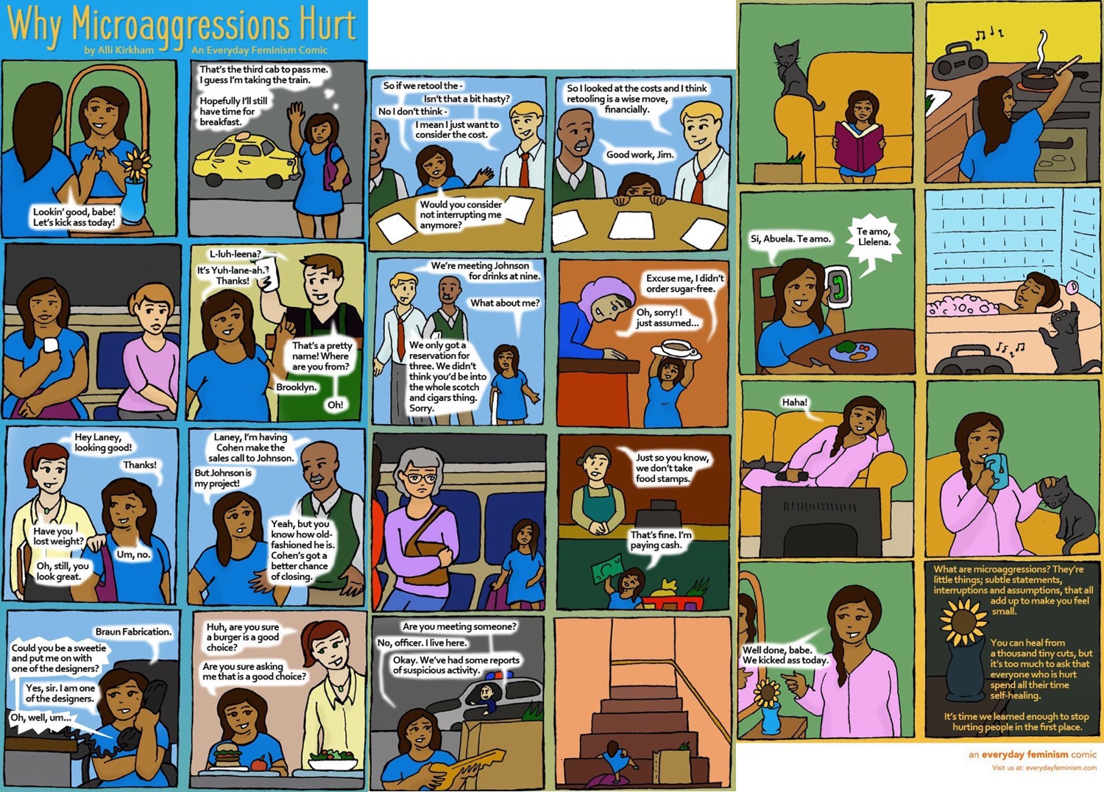
Microaggressions

Slide 19
Scenario
You walk into the breakroom. Moses is talking about how Ivy hasn't been seen in the office in days and she claims she is teleworking...but she is so slow in answering emails and isn't always available for chat. I guess she’s meeting deadlines but I don't know...seems like she’s not working as hard as we are…

Slide 20
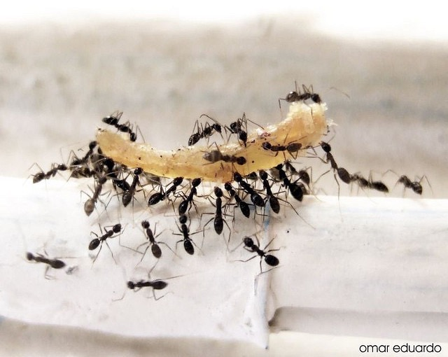
Individual Leadership
Shared Responsibility
Notes:
This program is about 2 things - Individual leadership and shared responsibility
Each Individual needs to make positive, informed decisions
We are part of a larger community and need to look out for each other. We’re trying to create the culture we want to be part of – one person, one decision at a time.

Slide 21
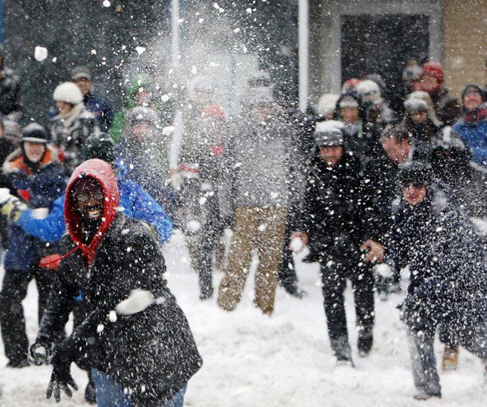
Notes:
SNOWBALL SURVEY
Ask students to complete the survey, but do NOT put their names on the survey. You can also ask them to complete the survey before the session.
When everyone is done, ask them to crumple up the paper into a ball and throw it, pick up another “snow ball” and throw it.
Repeat at least 3 times
Call “time” and make sure everyone has a snowball.
Open the paper up
For the next few questions, ask students to respond based on what is on their sheet of paper.
If they got their own paper, don’t mention it. No one will know!

Slide 22



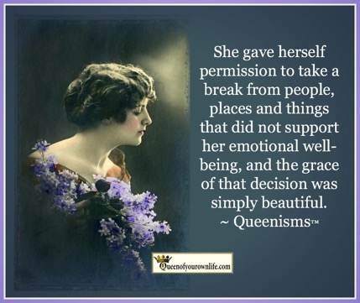


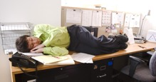
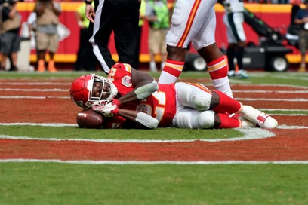

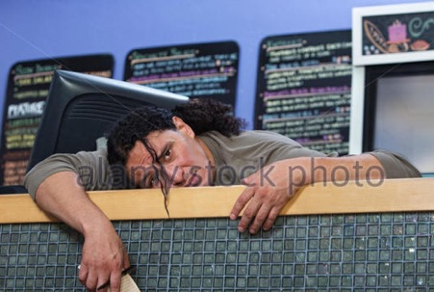
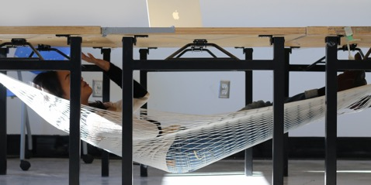
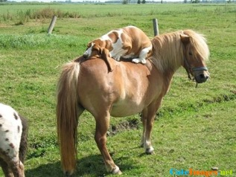
BREAK – 2 minutes

Slide 23
Variables
Individual
Target
Situational
Notes:
In any situation, there are factors that influence if someone will provide help
Individual variables are things like: knowledge/skills, confidence, sense of social responsibility, privilege.
Situational variables are things like: severity of need, number of other bystanders present, cost of helping.
Victim variables – are things like: appearance of victim, friendship with victim, perceived deservedness, whether they accept help, etc.
Ask which one they think is the best predictor for helping?
Answer: Situational variables are better predictors of Prosocial Behavior than are dispositional.

Slide 24
The Bystander Effect
People are less likely to help when they are in a group than when they are alone.
Notes:
Though most people believe that intervention is effective and necessary, there are barriers to action.
The Bystander Effect = the tendency for people NOT to Step Up in situations when others are present.
Research has shown that 80% of people help when they are the lone bystander while only 20% of people are likely to help when other bystanders are present.
Psychologists have researched why this occurs…

Slide 25
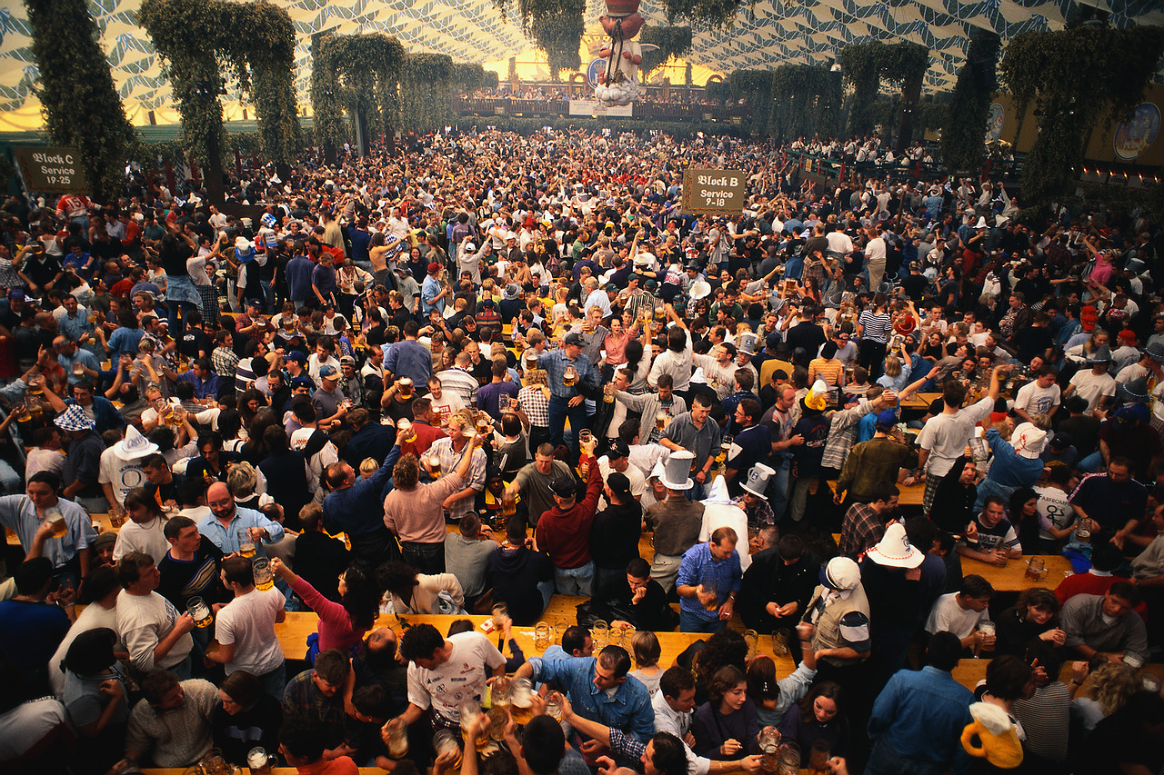
Diffusion of Responsibility

Slide 26
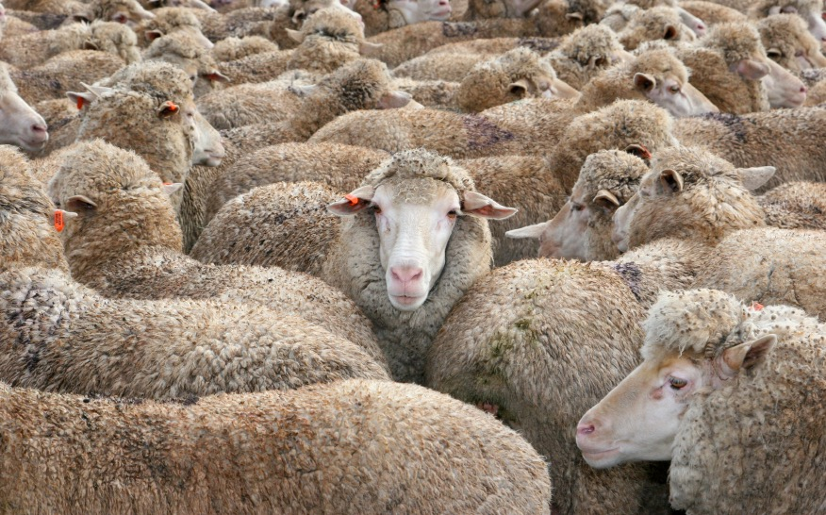
Conformity

Slide 27

Ambiguity
Notes:
You don’t know if a situation is a problem or not
It’s unclear if a problem is an emergency.
ASK: How do you resolve ambiguity? Check in with others, investigate, stay present

Slide 28
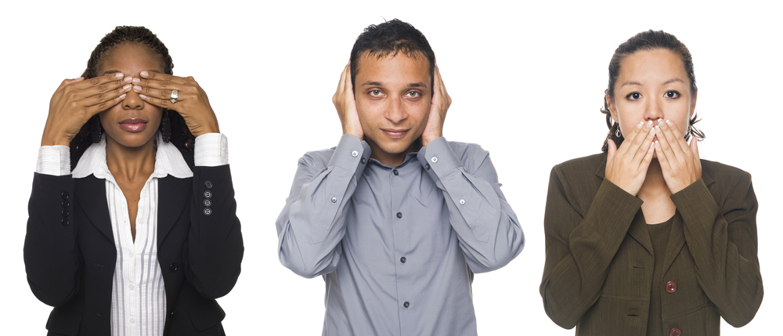
Willful Blindness
Notes:
Not having the courage to do something….
People in positions of authority KNOW and don’t do anything.

Slide 29
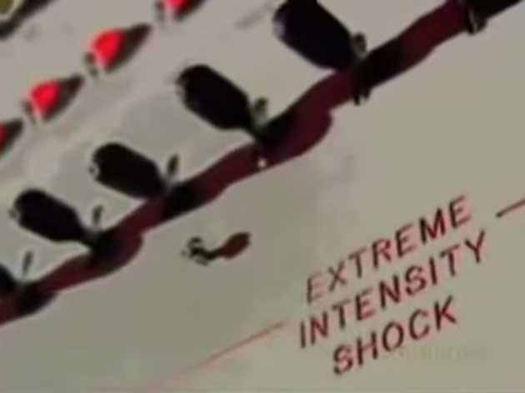
“All evil starts with 15 volts.” Philip Zimbardo
Respect/Fear of Authority
Notes:
Obedience to Authority.
Ex. The groundbreaking Milgram Experiment in 1964 demonstrated the tremendous pressure that a person in authority, in this case a research coordinator, exerts over others.
NOTE: you don’t need to provide great detail on the experiment although there is more info in the appendices.

Slide 30
Social and Cultural Identifiers
Ability-Mental and/or Physical
Ethnicity
Age
?
Internationalism
Gender
Sexual Orientation
Body Size/Shape
Socioeconomic Status
Race
Religious, Social, or Political Beliefs
Notes:
Identify within these variables.
Think about how these identities impact whether you’ll intervene.

Slide 31
Social and Cultural Identifiers
Step 1: Write down your identities i.e. your race, ethnicity, gender, sexual orientation, etc.
Step 2: Which identifiers most strongly have shaped your beliefs and are most likely relevant to you intervening?
Step 3: Share with one or two people near you.

Slide 32
DOMESTIC VIOLENCE VIDEO
Simulated Domestic Violence
Notes:
NOTE: This video clip shows two staged situations filmed in public locations. First, a woman is hit and verbally abused by her “boyfriend” and many people come to her aid. In the 2nd situation, a male is abused by his presumed girlfriend, but this time, no one helps him and one bystander even smacks him on the head.
You should provide brief background on the video content prior to showing (i.e., that this clip shows brief, staged verbal and physical abuse) to warn audience members.

Slide 33
What surprised you?
What do you think you would have done?
What social and cultural identifiers were at play?
Notes:
Focus on the discussion, not on the “right answer”
What are the barriers to action? What might motivate someone to act?
What does society teach us?
Avoiding intervention?

Slide 34
Because we’re busy
Office microaggressions

Slide 35
Reflect…
What surprised you?
What do you think you would have done?
What social and cultural identifiers were at play?
Notes:
Focus on the discussion, not on the “right answer”
What are the barriers to action? What might motivate someone to act?
What does society teach us?
Avoiding intervention?

Slide 36
BREAK – 5 minutes

Slide 37

From Passive to Active 5 Steps to Intervention

Slide 38
Identifying the Five Steps
STEPHEN JACKSON
VIDEO
Notes:
Should I get involved or not?
A joke isn’t funny unless everyone involved thinks it’s funny.

Slide 39
The Step UP! Model
Notice the Event
Interpret it as a problem
Assume personal responsibility
Know how to help
Implement the help – Step UP!
Latane and Darley
Notes:
For each decision making step, we will be discussing strategies to get better at it.
Failure at any one of these steps will result in no help being offered.

Slide 40
1. Notice the Event
AWARENESS VIDEO
Awareness Test
Notes:
Basketball passing awareness test.

Slide 41
2. Interpret it as a Problem
Legally Blonde
Notes:
From the movie Legally Blonde.

Slide 42
3. Assume Personal Responsibility
Rescuing a motorcyclist
Notes:
Acknowledge that if you don’t Step Up, no one else might.
Say you’ll help – OUT LOUD. Verbalizing your intentions makes follow through more likely.
We’re just asking you to take a small step outside your comfort zone - you don’t need to make a scene or embarrass others.
Enlist others to Step Up – I’ll do A, you do B.
BE THE FIRST!

Slide 43
4. Know how to Help
Matt Lauer
Matt Lauer

Slide 44
5. Implement the Help. StepUp!
3 WOMEN VIDEO
Foiled Date-rape attempt

Slide 45
BREAK – 5 minutes

Slide 46
Tools For the Toolkit
Motivational Interviewing
Watch your first thoughts
Hit the Pause button
Use the power of logic
Act as if the bias doesn’t exist
Cultivate common ground

Slide 47
Tools For the Toolkit
Speaking Out Against Stereotypes
Assume good Intent; Explain impacts
Ask an open-ended question
Interrupt and redirect
Broaden to universal human behavior
Make it individual
Say, “Ouch!”

Slide 48
Tools For the Toolkit
Five Ds of Intervention
Directly respond
Distract
Delegate
Delay
Document

Slide 49
Tools For the Toolkit
Four Steps to Safe Intervention
Engage conversation with the target
Ignore harassment
Keep building safe space
Continue conversation until harasser leaves

Slide 50
As a Team
Keep yourself safe.
Create Standards of Behavior.
Find Strength in Numbers.
Put Plans in Place.
Make Relevant to Team.
Explain Expectation to Intervene.
Empower Others to StepUP!
Reinforce Prosocial Behaviors.
Encourage Group to Share.
Practice Skills and Strategies.
Notes:
I Care “John, do you have a minute? Because you’re such a good friend and I really care about you, I want to talk to you about something very important.”
I See “I’ve been noticing that you are not coming in to work as often and your involvement hasn’t bee the same. From my perspective, you really don’t seem to be yourself.
I Feel “I’m worried about whatever it is that’s affecting you — personally, and at work. To be honest I’m also concerned about what could happen to you.”
I Want “John, I want what’s best for you and the team. I’d like to see you get some help and sooner rather than later — at least talk to someone — either your supervisor or even someone from the Employee Assistance Program. Will “I want to support you however I can because I respect you and you are very important to us.”

Slide 51
SNACK MAN VIDEO
Notes:
http://www.youtube.com/watch?v=Erlw-ODVZxU
NOTE: the video shows two people in a fight on a subway train and a man eating chips walks over and stands between them.
What do you think?
We do not advocate getting into the middle of a fight
Ask participants to notice 3 things in the video (and see afterwards if they got all 3.) Here’s what they should notice::
Snack man does not escalate situation – just stands in between without saying a word.
The woman then gets involved
The other person is videotaping

Slide 52
Scenario
You are at a conference and notice that a senior, male scientist has been giving extraordinary attention to a young female scientist and her poster. A bit later you see him lead her away from her poster and say that he “would like to talk to her about her work in a more private setting.” What do you do?
What issues are ambiguous in this scenario?
What are some direct and indirect ways to help?
Notes:
Others – meeting interruptions or call-outs
Credit-taking for others ideas
Hazing/ antagonism /drinking at meetings/trainings
Not intervening when drinking involved?
Safe to get away and address tomorrow?
Micro-aggressions (see if anyone has one in the audience)
Other stories from audience?

